Slide 1
Lipid Metabolism
Dr Nikunj Bhatt

Slide 2
Classification
These organic compounds are nonpolar molecules, which are soluble only in nonpolar solvents and insoluble in water because water is a polar molecule. In the human body, these molecules can be synthesized in the liver and are found in oil, butter, whole milk, cheese, fried foods and also in some red meats.

Slide 3
Properties of Lipids
Lipids are a family of organic compounds, composed of fats and oils. These molecules yield high energy and are responsible for different functions within the human body. Listed below are some important characteristics of Lipids.
Lipids are oily or greasy nonpolar molecules, stored in the adipose tissue of the body.
Lipids are a heterogeneous group of compounds, mainly composed of hydrocarbon chains.
Lipids are energy-rich organic molecules, which provide energy for different life processes.
Lipids are a class of compounds characterised by their solubility in nonpolar solvents and insolubility in water.
Lipids are significant in biological systems as they form a mechanical barrier dividing a cell from the external environment known as the cell membrane.

Slide 4
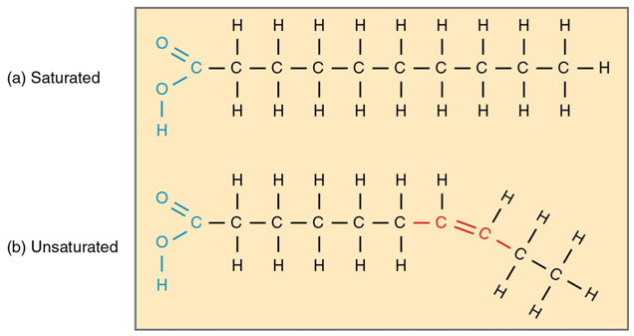
Lipid Structure

Slide 5
Non saponifiable Lipids
A non saponifiable lipid cannot be disintegrated into smaller molecules through hydrolysis. Nonsaponifiable lipids include cholesterol, prostaglandins, etc
Saponifiable lipids

Slide 6
Saponifiable Lipids
A saponifiable lipid comprises one or more ester groups, enabling it to undergo hydrolysis in the presence of a base, acid, or enzymes, including waxes, triglycerides, sphingolipids and phospholipids.
Further, these categories can be divided into non-polar and polar lipids.
Nonpolar lipids, namely triglycerides, are utilized as fuel and to store energy.
Polar lipids, that could form a barrier with an external water environment, are utilized in membranes. Polar lipids comprise sphingolipids and glycerophospholipids.
Fatty acids are pivotal components of all these lipids.

Slide 7
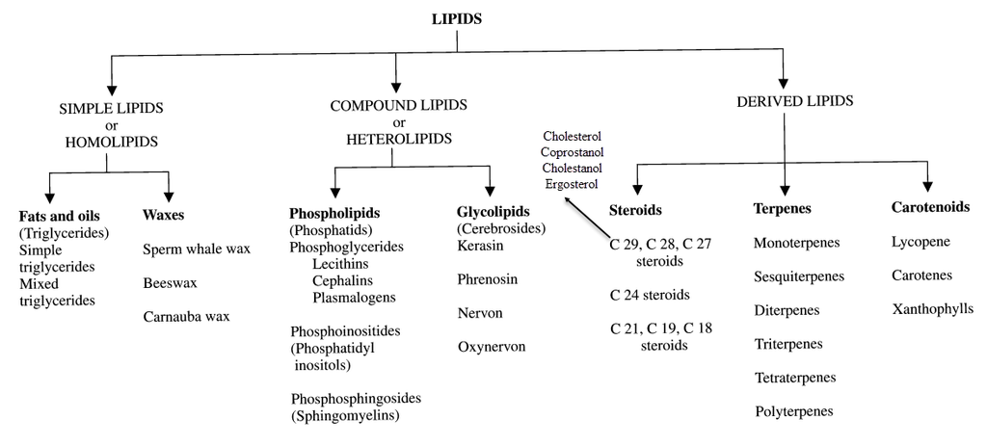
Classification of Lipids

Slide 8
Most lipids, such as triglycerides, are nonpolar and therefore very hydrophobic molecules. They do not dissolve in water. To be transported in watery blood, such molecules first must be made more water-soluble by combining them with proteins produced by the liver and intestine. The lipid and protein combinations thus formed are lipoproteins

Slide 9
Chylomicrons
which form in mucosal epithelial cells of the small intestine, transport dietary (ingested) lipids to adipose tissue for storage. They contain about 1–2% proteins, 85% triglycerides, 7% phospholipids, and 6–7% cholesterol, plus a small amount of fat-soluble vitamins

Slide 10
Very-low-density lipoproteins (VLDLs)
form in hepatocytes, contain mainly endogenous (made in the body) lipids. VLDLs contain about 10% proteins, 50% triglycerides, 20% phospholipids, and 20% cholesterol. VLDLs transport triglycerides synthesized in hepatocytes to adipocytes for storage they deposit some of their triglycerides in adipose cells, VLDLs are converted to LDLs.

Slide 11
low-density lipoproteins (LDLs)
contain 25% proteins, 5% triglycerides, 20% phospholipids, and 50% cholesterol. They carry about 75% of the total cholesterol in blood and deliver it to cells throughout the body for use in repair of cell membranes and s
When present in excessive numbers, LDLs also deposit cholesterol in and around smooth muscle fibers in arteries, forming fatty plaques that increase the risk of coronary artery disease synthesis of steroid hormones and bile salts.

Slide 12
High-density lipoproteins (HDLs)
which contain 40–45% proteins, 5–10% triglycerides, 30% phospholipids, and 20% cholesterol, remove excess cholesterol from body cells and the blood and transport it to the liver for elimination. Because HDLs pre- vent accumulation of cholesterol in the blood, a high HDL level is associated with decreased risk of coronary artery disease. For this reason, HDL-cholesterol is known as “good” cholesterol

Slide 13
Sources and Significance of Blood Cholesterol
There are two sources of cholesterol in the body. Some is present in foods (eggs, dairy products, organ meats, beef, pork, and processed luncheon meats), but most is synthesized by hepatocytes. Fatty foods that don’t contain any cholesterol at all can still dramatically increase blood cholesterol level in two ways. First, a high intake of dietary fats stimulates reabsorption of cholesterol containing bile back into the blood, so less cholesterol is lost in the feces. Second, when saturated fats are broken down in the body, hepatocytes use some of the breakdown products to make cholesterol.

Slide 14
The Fate of Lipids
Lipids, like carbohydrates, may be oxidized to produce ATP.
If the body has no immediate need to use lipids in this way, they are stored in adipose tissue (fat depots) throughout the body and in the liver.
A few lipids are used as structural molecules or to synthesize other essential substances. Some examples include phospholipids, which are constituents of plasma membranes; lipoproteins, which are used to transport cholesterol throughout the body; thromboplastin, which is needed for blood clotting; and myelin sheaths, which speed up nerve impulse conduction.
Two essential fatty acids that the body cannot synthesize are linoleic acid and linolenic acid.
Dietary sources include vegetable oils and leafy vegetables.

Slide 15
Triglyceride Storage
A major function of adipose tissue is to remove triglycerides from chylomicrons and VLDLs and store them until they are needed for ATP production in other parts of the body. triglycerides stored in adipose tissue constitute 98% of all body energy reserves. They are stored more readily than glycogen, in part because triglycerides are hydrophobic and do not exert osmotic pressure on cell membranes.

Slide 16
Lipolysis
In order for muscle, liver, and adipose tissue to oxidize the fatty acids derived from triglycerides to produce ATP, the triglycerides must first be split into glycerol and fatty acids, a process called lipolysis
Lipolysis is catalyzed by enzymes called lipases.
Epinephrine and norepinephrine enhance and cortisol, thyroid hormones triglyceride breakdown into fatty acids and glycerol.

Slide 17
Lipolysis
These hormones are released when sympathetic tone increases, as occurs, for example, during Exercise.
The glycerol and fatty acids that result from lipolysis are catabolized via different pathways Glycerol is converted by many cells of the body to glyceraldehyde 3-phosphate, one of the compounds also formed during the catabolism of glucose.

Slide 18
Lipolysis
If ATP supply in a cell is high, glyceraldehyde 3-phosphate is converted into glucose, an example of gluconeogenesis. If ATP supply in a cell is low, glyceraldehyde 3-phosphate enters the catabolic pathway to pyruvic acid.

Slide 19
Lipolysis
Fatty acids are catabolism is different than glycerol and yield more ATP.
The first stage in fatty acid catabolism is a series of reactions, collectively called beta oxidation , that occurs in the matrix of mitochondria.

Slide 20
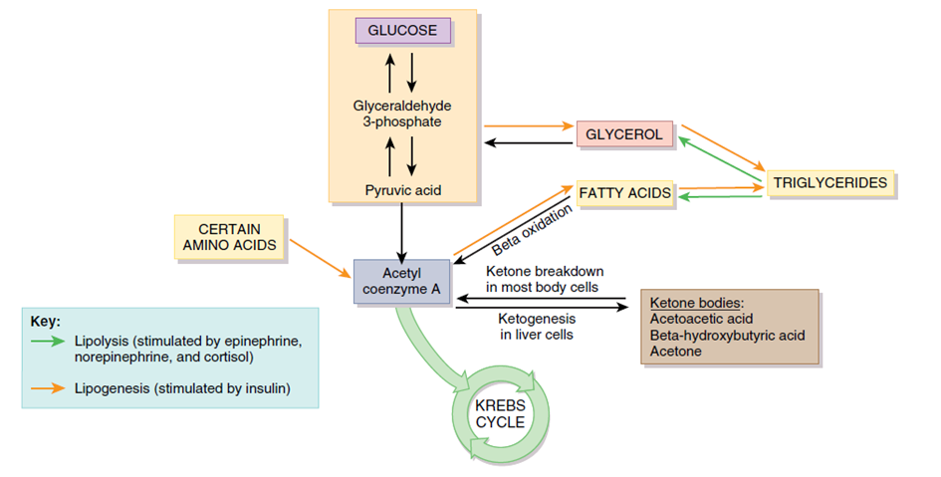
Lipolysis

Slide 21
Lipid Anabolism: Lipogenesis
Liver cells and adipose cells can synthesize lipids from glucose or amino acids through lipogenesis
stimulated by insulin.
Lipogenesis occurs when individuals consume
more calories than are needed to satisfy their
ATP needs.

Slide 22
The use of glucose to form lipids takes place via two pathways:
(1) glucose > glyceraldehyde 3-phosphate > glycerol and
(2) glucose > glyceraldehyde 3-phosphate > acetyl CoA > fatty acids.
The resulting glycerol and fatty acids can undergo anabolic reactions to become stored triglycerides, or they can go through a series of anabolic reactions to produce other lipids such as lipoproteins, phospholipids, and cholesterol.

